Slide 1
Research Report
03/15/2024
Yu Li

Slide 2
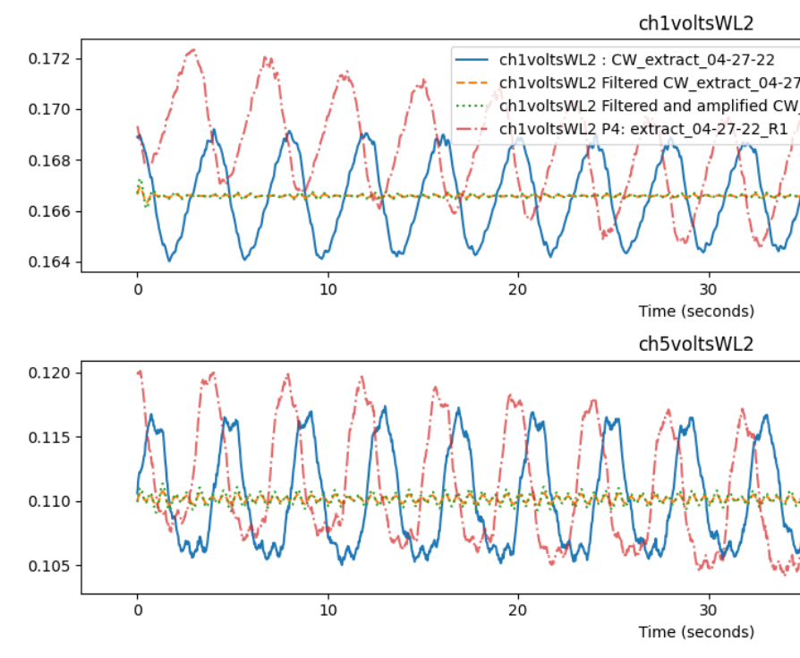
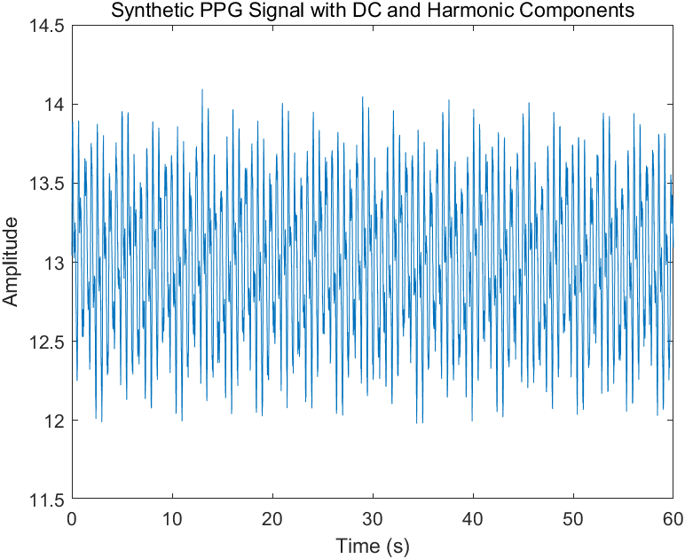
Simulation signal
mhr_signal = 0.5 * sin(2 * pi * mhr_freq * t); % MHR
fhr_signal = 0.2 * sin(2 * pi * fhr_freq * t); % FHR
resp_freq = 0.25; % Respiration frequency
resp_signal = 0.1 * sin(2 * pi * resp_freq * t); % Respiration dc_component = 25*0.5=12.5; % DC component

Slide 3
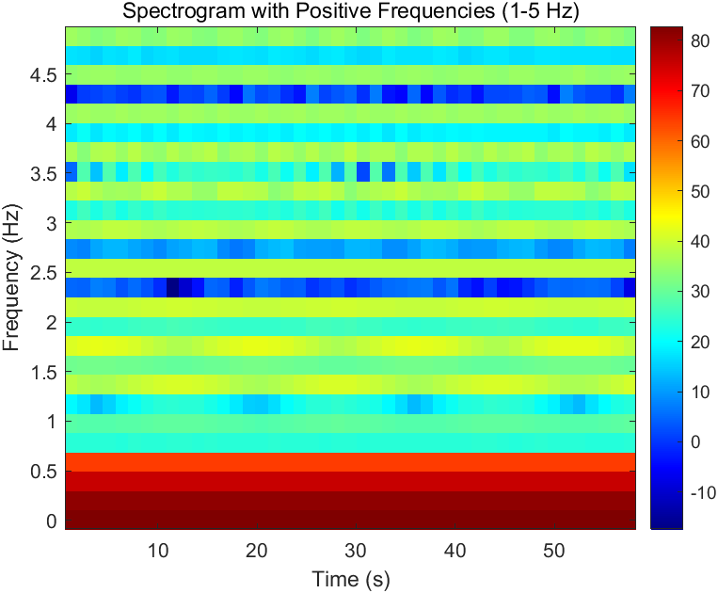
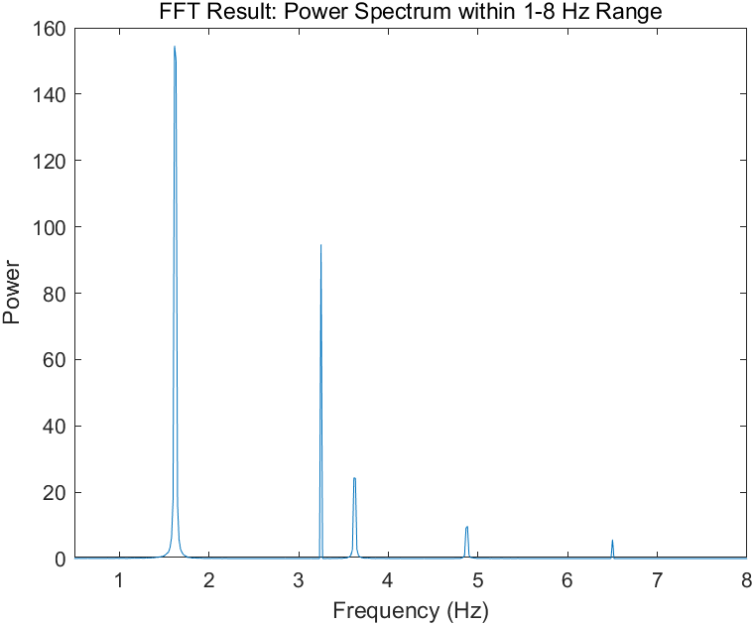
Simulation signal
(Imax-Imin)/Imin
Energy of f_MHR /total signal energy
Time Domain Relative Change: 0.17563
Frequency Domain Relative Change using FFT (excluding DC, FHR, and respiration): 0.16707

Slide 4
Simulation signal
FHR Time Domain Relative Change (Method 3: removing MHR, respiration, and harmonics): 0.053647
FHR Frequency Domain Relative Change using FFT (excluding DC, MHR, and respiration): 0.048744
MHR
FHR

Slide 5
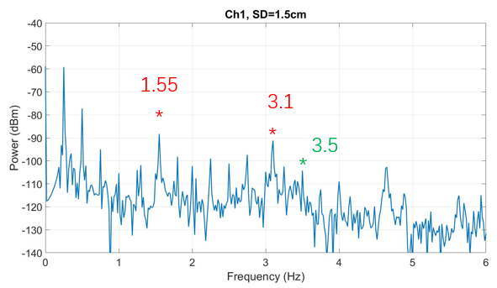
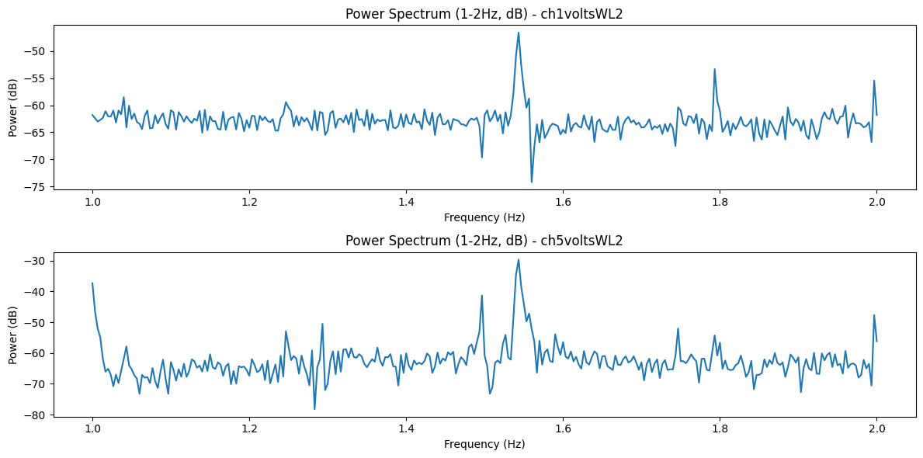
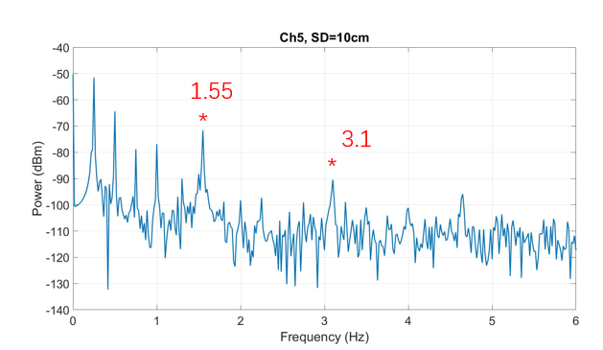
One-subject Model (WL2)
Records:
FFT results:
MHR
MHR
Relative Change (Time Domain) - ch1voltsWL2: 0.005221932114882504
Relative Change (Time Domain) - ch5voltsWL2: 0.06210315734539451
MHR Relative Change (Frequency Domain) - ch1voltsWL2: 0.0020559483681030365
MHR Relative Change (Frequency Domain) - ch5voltsWL2: 0.007261236666173506

Slide 6
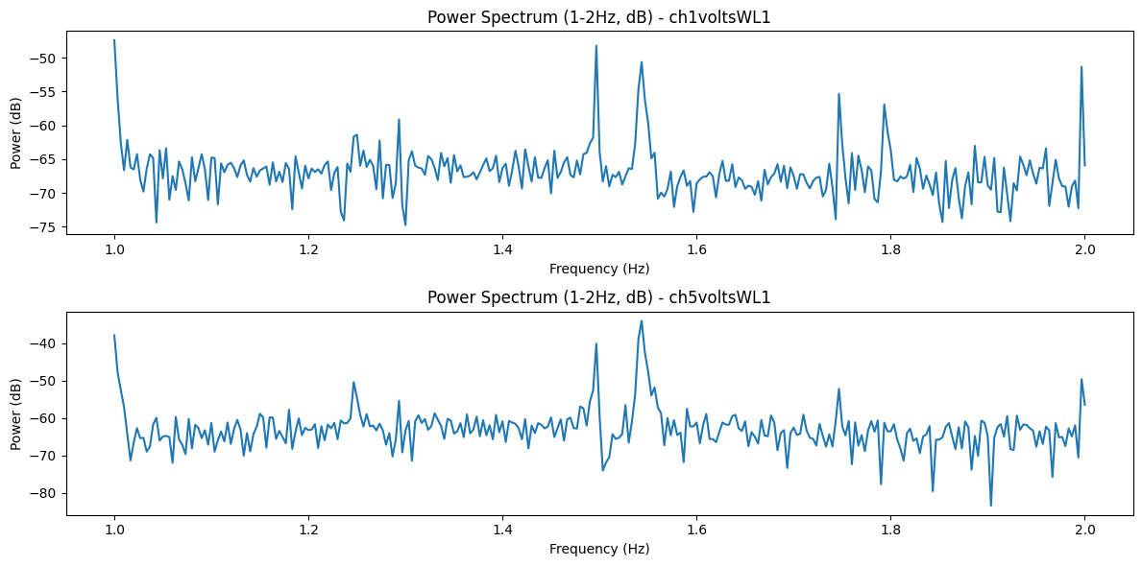
One-subject Model (WL1)
Relative Change (Time Domain) - ch1voltsWL1: 0.017430231450614328
Relative Change (Time Domain) - ch5voltsWL1: 0.05103702130671759
MHR Relative Change (Frequency Domain) - ch1voltsWL1: 0.0044628192414694596
MHR Relative Change (Frequency Domain) - ch5voltsWL1: 0.021324703210207257

Slide 7
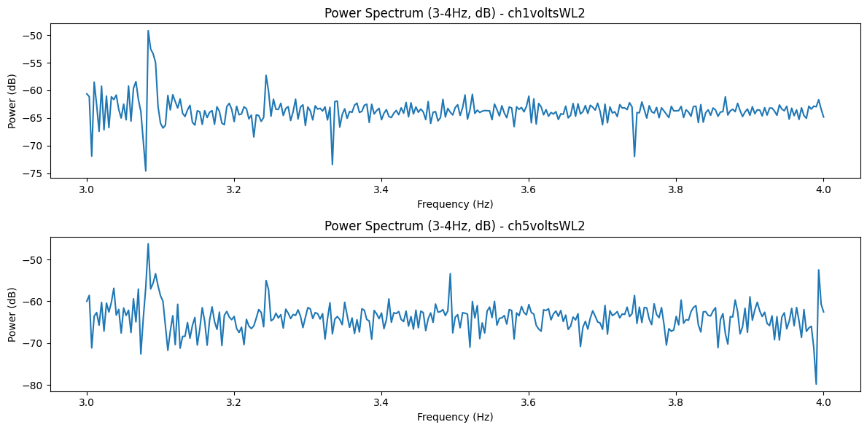
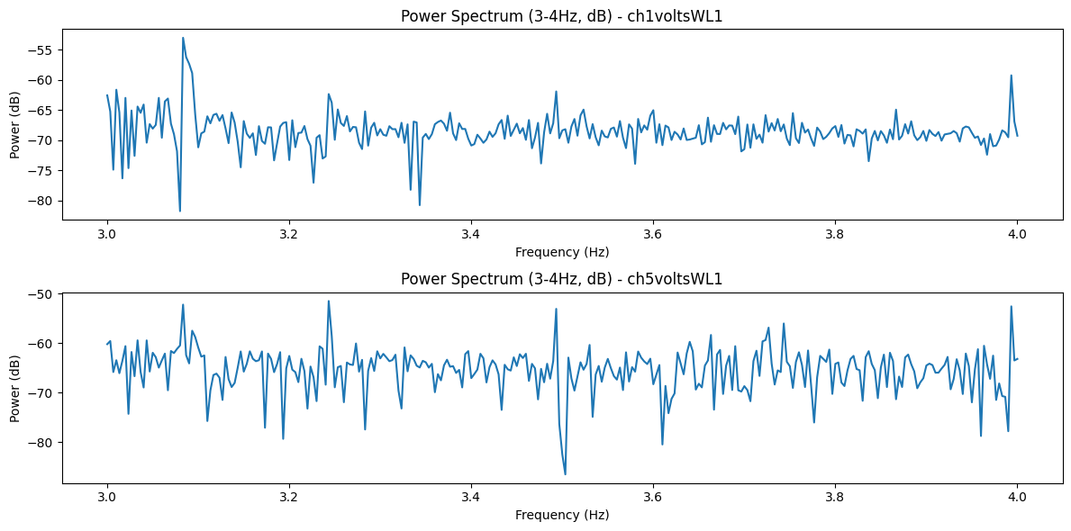
Two-subject Model (WL2)
FHR Relative Change (Time Domain) - ch5voltsWL2: 0.002154139907870819
FHR Relative Change (Frequency Domain) - ch5voltsWL2: 0.000634686129705678

